Slide 1
FOUNDATIONS
(8000BCE) – 600 BCE
Ch 1

Slide 2

NEOLITHIC REVOLUTION
Change from Nomadic to Agricultural societies
  What does this mean?
Took hundreds, perhaps 1,000 of years for the change to take place
Where did it take place first?
Slash and burn
Breeding of animals for labor and food=stability
What does stability =?
  Population increase!

Slide 3

NEOLITHIC REVOLUTION
Job specialization b/c not everyone needed to farm…what other jobs did people began doing?
Religion
  What did they pray for?
Change in gender roles
  What happened to the role of women?

Slide 4
IDENTIFYING CHARACTERISTICS OF CITIES/CIVILIZATIONS
Surplus food
Specialization of workers
Trade
Social stratification
Organized government
Complex religions
Written language
Arts/architecture
Where were the first cities located? What geographical aspect did most of these cities share?

Slide 5
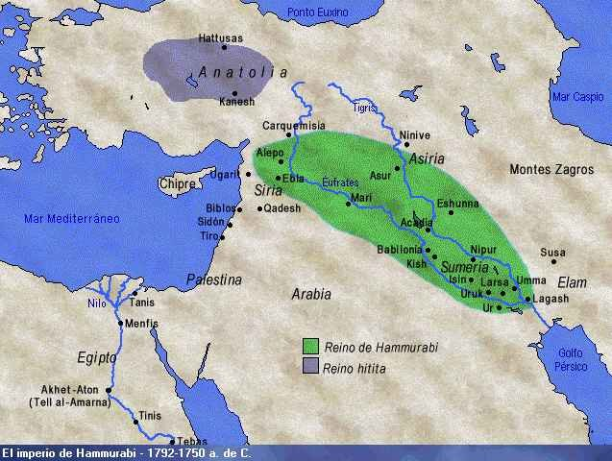
MESOPOTAMIA
AKA-Fertile Crescent 3500BCE-1700BCE
  Rivers: Tigris and Euphrates
  Sumer arrived around 3000 BCE
    Pop. 100,000
    Kings ruling city-states
    Social structure
    Cuneiform
    Epic of Gilgamesh

Slide 6
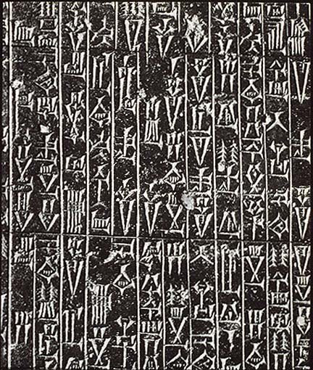

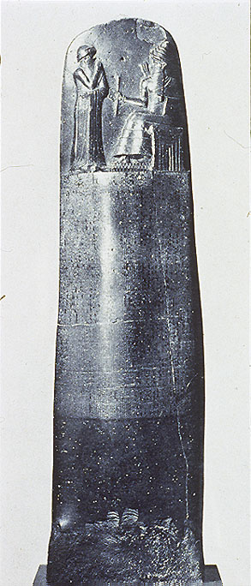
MESOPOTAMIA
Hammurabi (1792-1750BCE)
  1st Written Legal codes/laws
  Documented on rock edicts around the kingdom
  Strict punishment for crimes

Slide 7
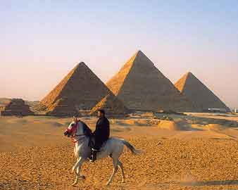
EGYPT
Nile River Valley
  Predictable; gave silt
  5000BCE
  Geography protects Egypt
  Hieroglyphics
  Polytheistic
  Pharaohs-gods on earth
  Pyramids of Giza
    84,000 laborers; 20 years
  Used bronze weapons, skilled in math, medicine, mummification, astronomy

Slide 8
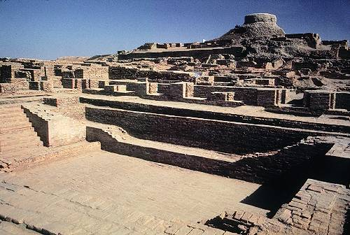
INDUS
Polytheistic
Larger than Mesopotamia and Egypt
3000BCE-2500 BCE
Rivers: Indus, Ganges, Brahmaputra
Harappa and Mohenjo-Daro
  Grid patterned city streets
  Private bathrooms with sewage systems
  Traded with Mesopotamia (Soapstone Seals were found)
  Discovered a writing system we still haven’t deciphered
  Declined around 2000bce…why?
1700BCE – Aryans (Indo-European nomads)
  Came into India and dominated—Vedas/Caste System

Slide 9

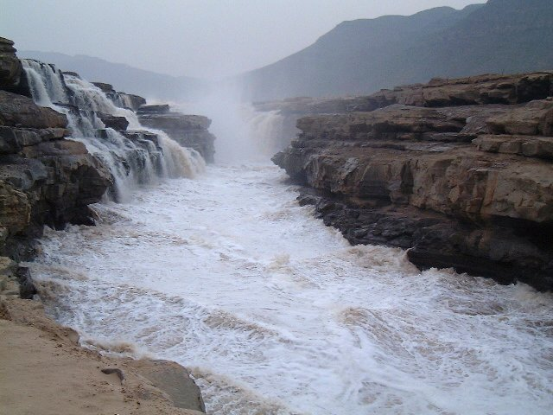
CHINA
Huang He (Yellow River, River of Sorrows)
  Loess; unpredictable
Shang Dynasty
  1766-1122BCE
  Oracle Bones
  Bronze weapons
Zhou
  1122-256BCE
  Mandate of Heaven
  Family unit was #1
  Era of Warring States

Slide 10
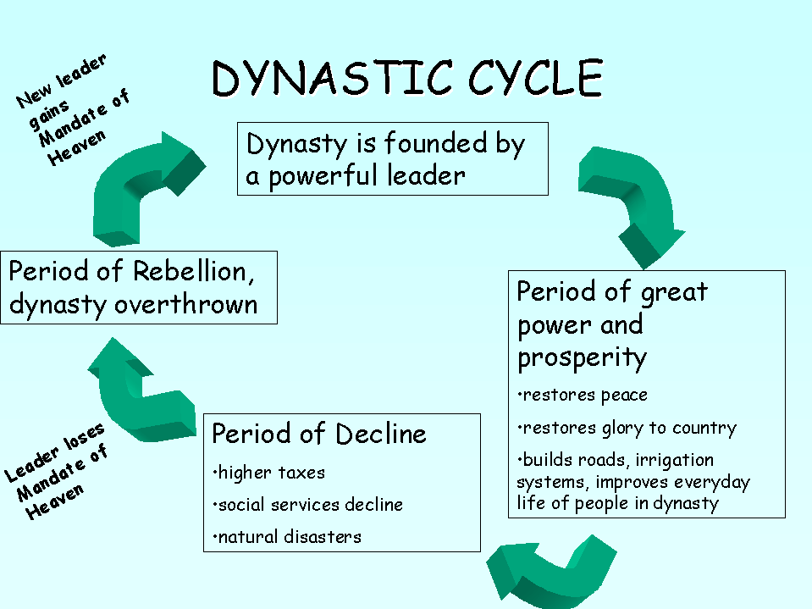
CHINA

Slide 11
Civilization | Mesopotamia | Nile | INDUS | CHINESE
Geography | Fertile Crescent Tigris/Euphrates Rivers | N. Africa/ Mediterranean Nile River | Northern Indian Subcontinent Indus and Ganges Rivers | Eastern China Yellow/Yangtze Rivers
Characteristics | + Fertile land between two rivers + Hammurabi-1st code of laws + Silt for crops | + Desert + Pyramids + Rosetta Stone | + Indus-Ganges Plain + Monsoons + Planned Cities | + loess + massive flooding + dynastic rule +Oracle Bones
 | + First civilization – Sumer + Use of irrigation + City states + Cuneiform Writing + Polytheistic | + Lower Egypt= north + Upper Egypt= south + Divided Kingdoms +Hieroglyphics +united by Menes | + Indoor Plumbing + Few Weapons + Toys + Not deciphered Written Language + Polytheistic +Harrapa & Mohenjo-Daro | + society based on family + religion based on pleasing ancestors + advanced technology +Mandate of Heaven
Fall | Defeated by Sargon – 1st Empire Builder | Defeated by the Hyksos | Unknown – Invasion? Disease? | Warring Dynasties

Slide 12
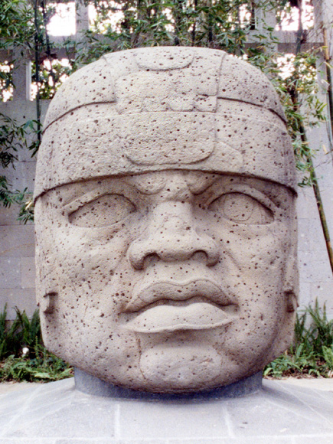
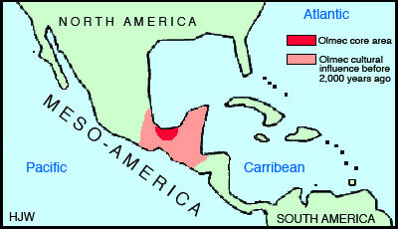
MESOAMERICA AND SOUTH AMERICA (LATIN AMERICA)
Olmec
  Near Gulf of Mexico
  1500BCE
  Not around a river valley
  Had religious, political, and economic centers
  Colossal Heads
    6ft high and 16-18 tons
  What happened to them? It’s a mystery…

Slide 13
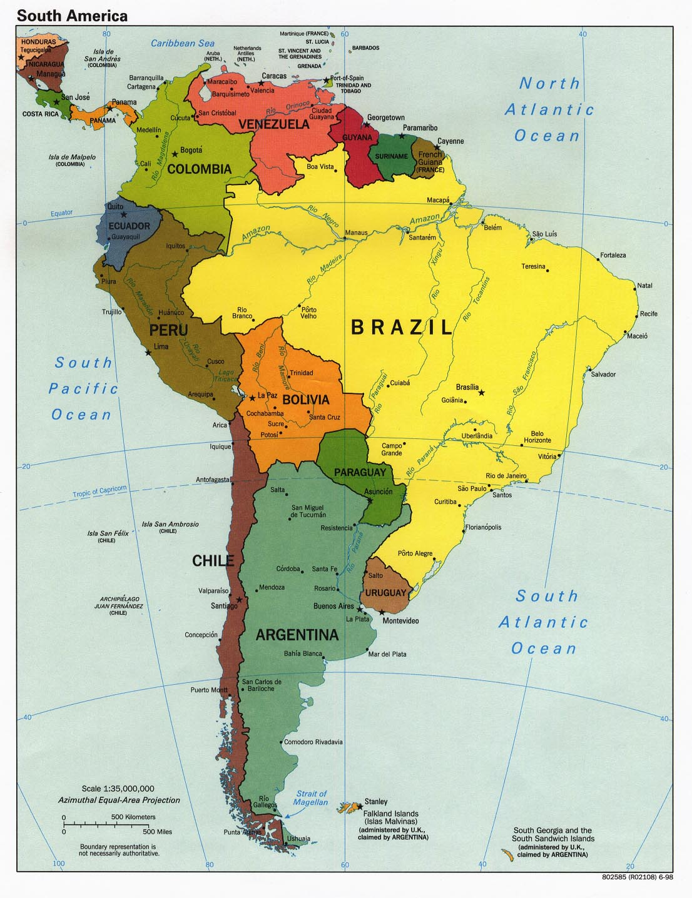
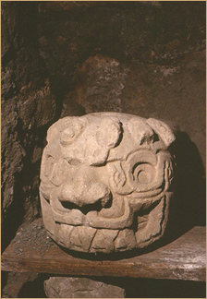
PRE-ANDEAN/PRE-INCAN
South America
  Peru and Bolivia
  Chavin 1500-300BCE
Agricultural Society/Peaceful
Elaborate Cities
Religious Monuments
Crazy thing is….they developed independent of other developments
  This was a drawback: they never learned some technology (i.e. the wheel and iron)

Slide 14
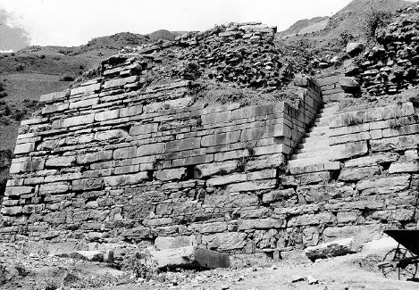
Chavin wall that remains today
Chavin Religious Site

Slide 15
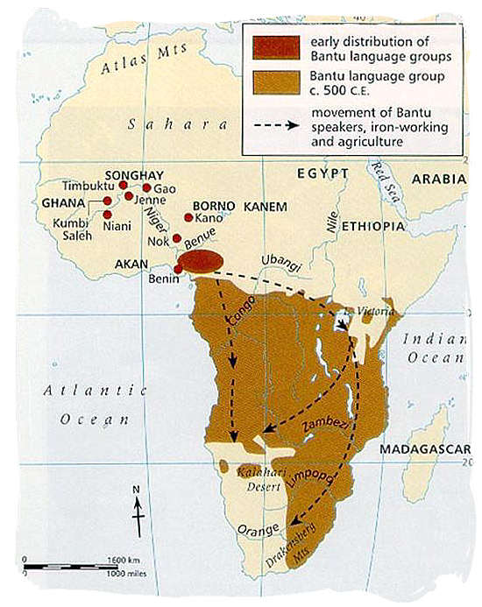
BANTU MIGRATION
Bantu
  2000BCE-1000BCE
  Sub-Saharan Africa (moved from what is Nigeria today)
  Push/Pull Factors: few resources, too many people
  Intermarried with locals, many adopted Bantu language
  1000BCE: iron tools=expanded Agriculture
  500CE: Bananas arrived via Indian Ocean trade; cultivated forested regions and continued to migrate
  Population: 3.5million in 400BCE to 22 million in 1000CE
  500+ languages that are related back to the Bantus

Slide 16
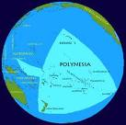

POLYNESIAN MIGRATION
60,000 years ago, humans moved to Australia
Ice age lowed the water levels and many land bridges were exposed
2000BCE
  Polynesians moved to Fiji, Samoa and then later Hawaii
Long distance sea trips on double canoes with triangular sails
As they migrated they introduced new items
  Yams, bananas, dogs, pigs, chickens
Gov’t: hierarchical with a Chief
  Passed down the right to rule to oldest son; relatives were local aristocracy

Slide 17
THE MAIN TAKE AWAYS FROM THIS PPT/CHAPTER…
People stopped chasing their food and penned it in
  it was much more convenient
People settled down in civilizations, divided the work
  Much more efficient
What are the main “Cultural Hearths”?
  Can you name them?

